Slide 1

Exploratory Data Analysis on AMEO Dataset
-By
B. Sai Spandhana

Slide 2
About me
I'm a recent Computer science engineering graduate with a passion for leveraging data to drive impactful insights and solve complex problems.
My engineering background has honed my analytical and problem-solving skills, and now I'm thrilled to apply these skills to the world of data science. I believe in the power of data to uncover hidden patterns, inform decision-making, and drive innovation.
Let's Connect! I'm excited to connect with professionals in the data science community, learn from your experiences, and explore potential collaborations. Feel free to reach out if you share a passion for transforming data into actionable insights.
LinkedIn : www.linkedin.com/in/bodaspandhana

Slide 3
Objective
This analysis aims to gain insights and understanding from the provided dataset, particularly focusing on the relationship between various features and the target variable, which is Salary.
Specifically, the goals of this analysis include:
• Describing the dataset and its features comprehensively.
• Identifying any patterns or trends present in the data.
• Exploring the relationships between independent and target variables (Salary).
• Identifying any outliers or anomalies in the data.

Slide 4
Data Cleaning
Data type conversion of all the columns consisting dates to datetime Datatype.
columns with over 80% -1 values, including 'MechanicalEngg', 'ElectricalEngg', 'TelecomEngg', and 'CivilEngg', were removed from further analysis.
Lastly, for the remaining optional subject columns, 'ElectronicsAndSemicon' and 'ComputerScience', -1 values were replaced with 0, indicating that the subjects were not pursued.

Slide 5
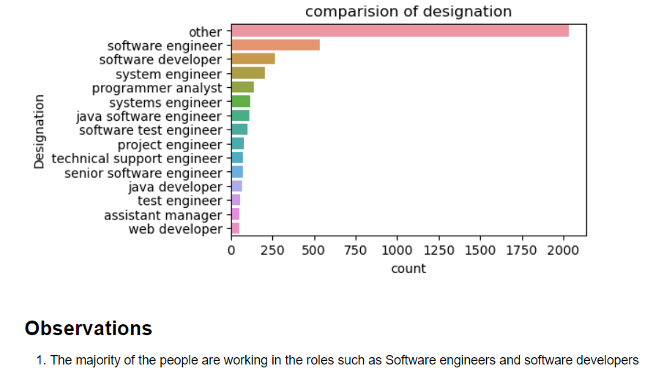
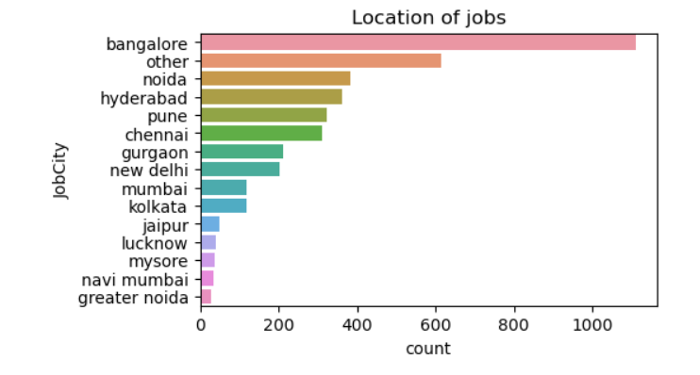
Univariate Analysis
1.The majority of the people are working in the roles such as Software engineers and software developers
2. The location with highest number of people working there is banglore and then follwed by other cities such as noida , hyderabad, pune and chennai

Slide 6
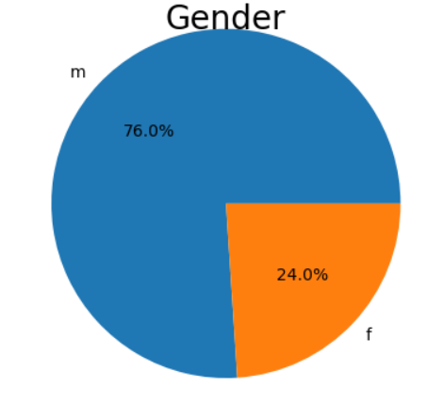
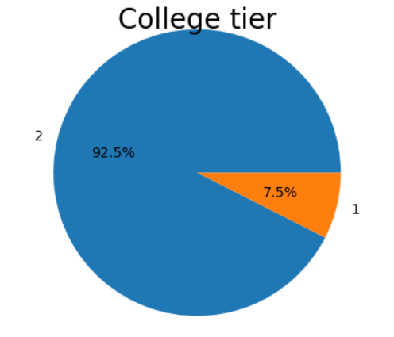
Gender
College Tier
There are more percentage of males.
Most of the candidates are from tier 2 colleges.

Slide 7
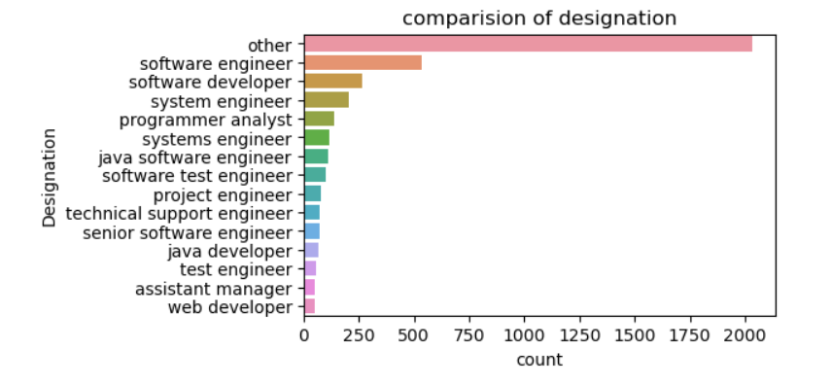
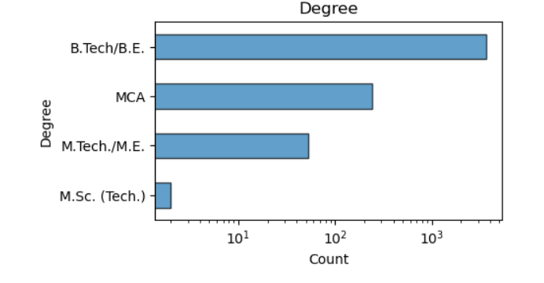
Degree
Designation
Most of the people are from B.TECH and B.E
Most of the people are working as software engineers.

Slide 8
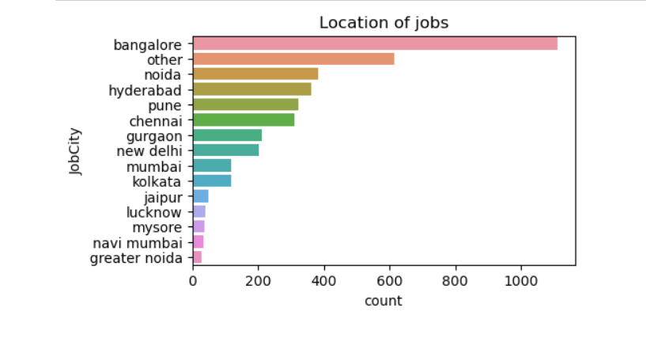
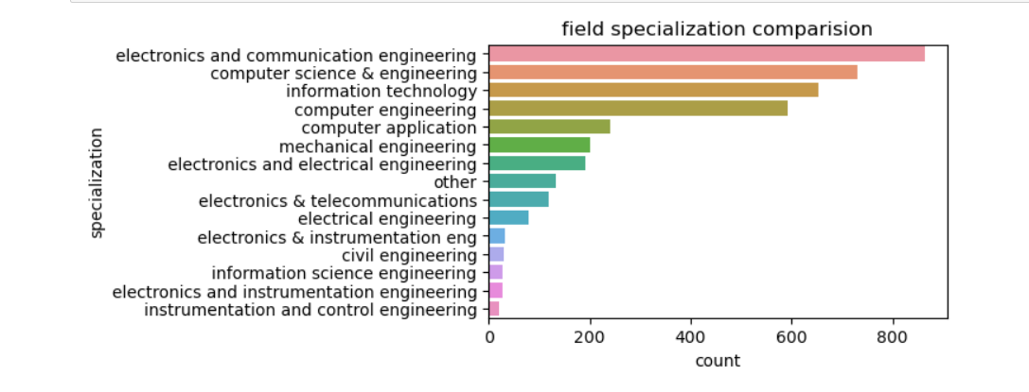
Location of Jobs
Specialization
Some of the popular locations are Bangalore , Noida and Hyderabad.
Most of the people are specialized ECE,CSE and IT.

Slide 9
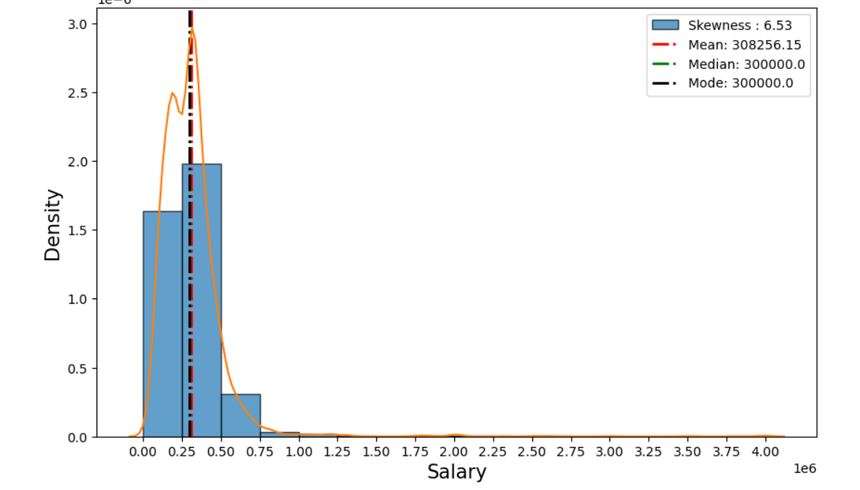
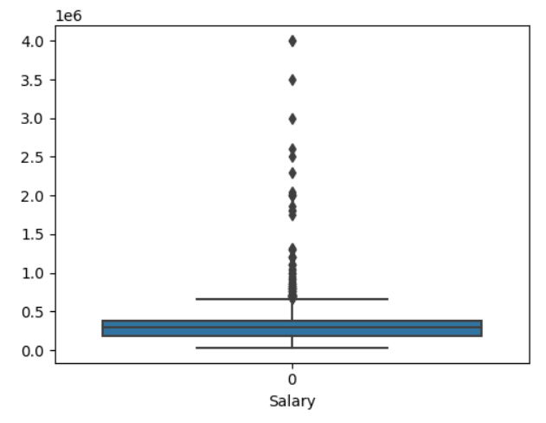
Salary Analysis
The measures of central tendency (mean, median, and mode) are approximately equal.
There is a notable concentration of data points with high salaries, as depicted by the box plot.

Slide 10
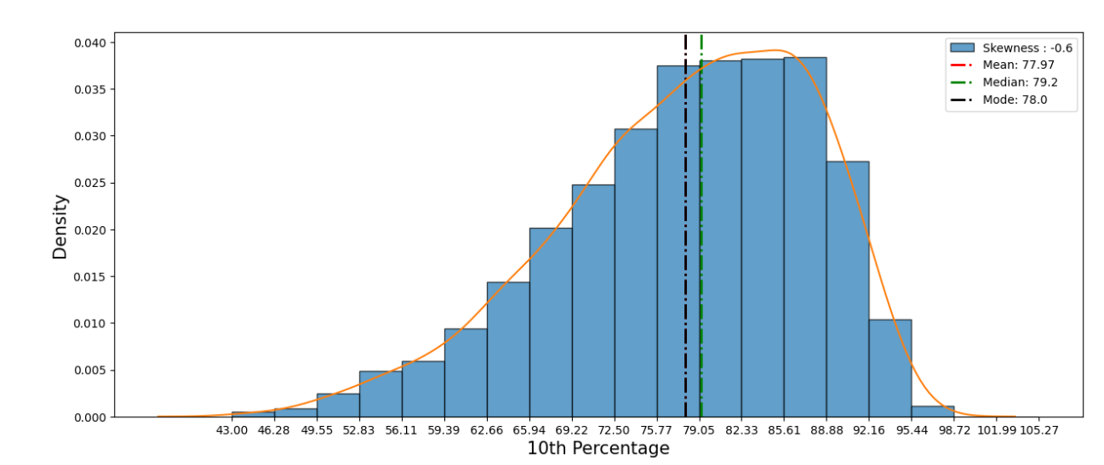
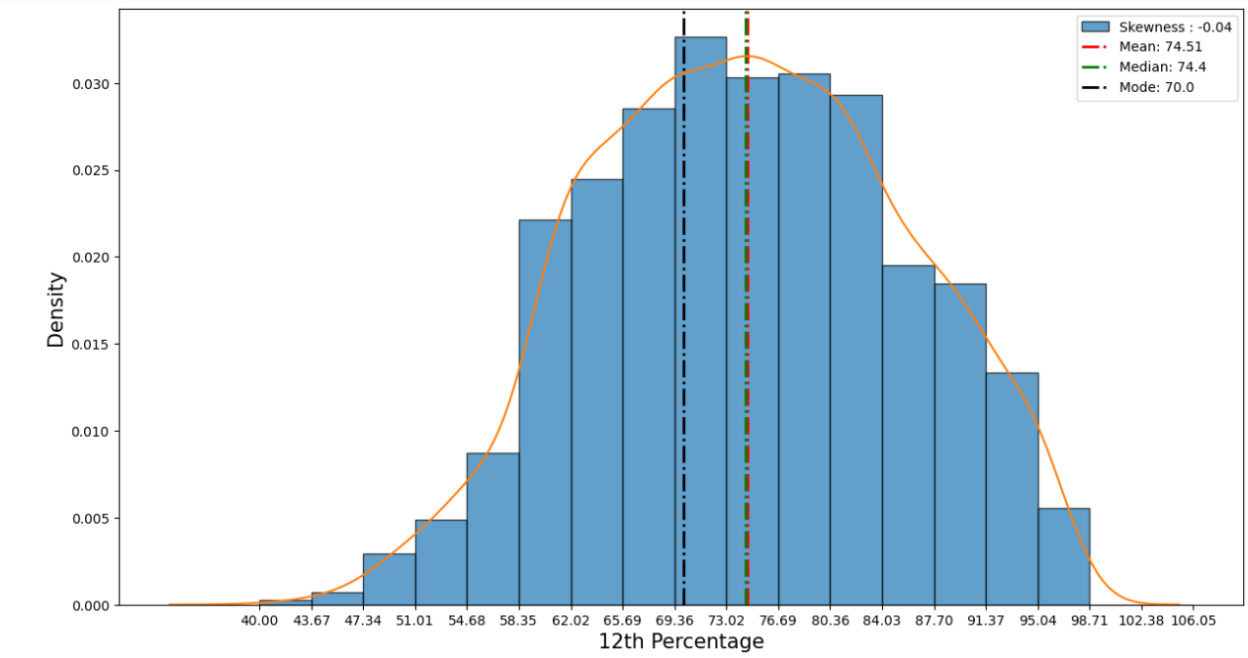
10th Scores
12th Scores
The histogram depicts a that there are very less number of students with low percentages, with the majority falling within the 75% to 90% range. The peak frequency occurs at 78%, and the average score lies around 77%.
The histogram illustrates a scarcity of students with low percentages, with the majority scoring between 69% and 84%. The peak frequency occurs at 70%, and the average score is around 74%.

Slide 11
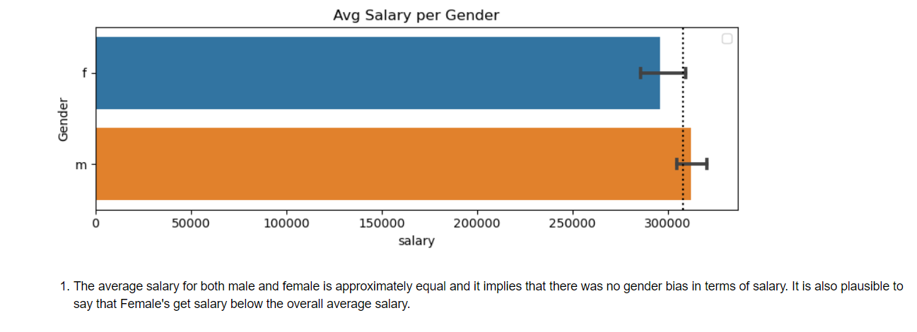
Gender vs Salary

Slide 12
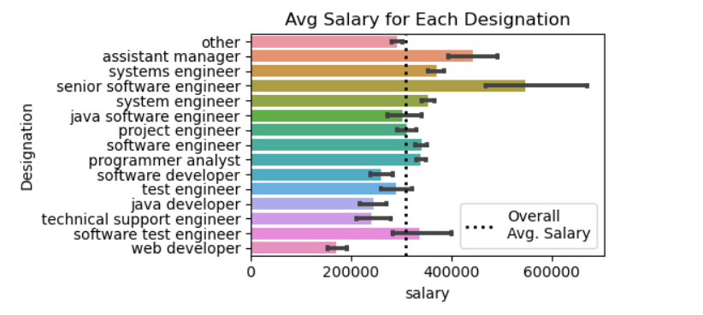
Avg Salary vs Designations
There are only two designations namely, software developer and technical support engineer who has salary lower than average salary.

Slide 13
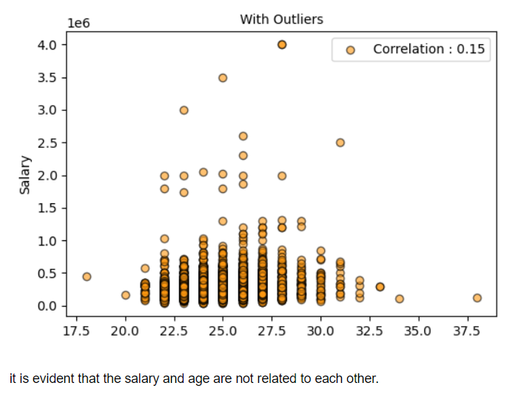
Salary vs Age

Slide 14
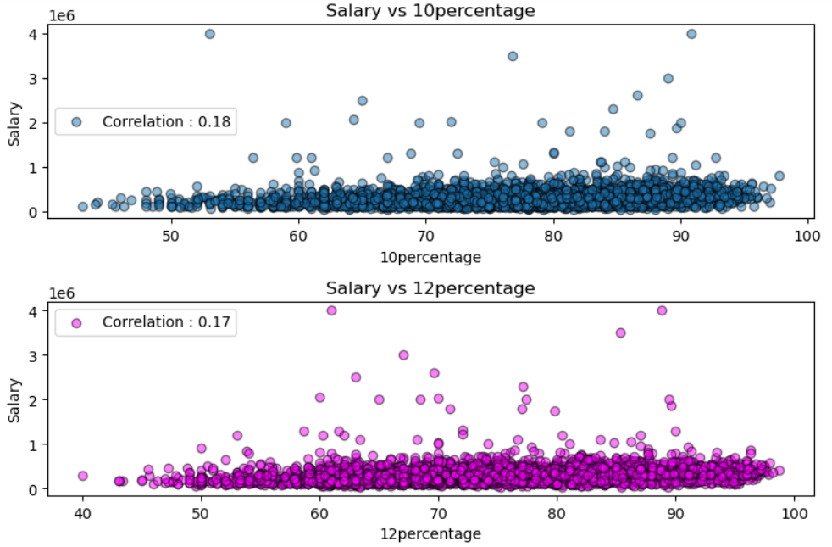
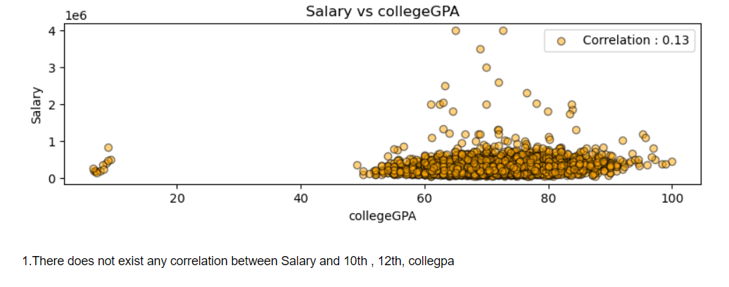
Salary vs 10th,12th percentage and collegegpa
There dosen’t exist any relationship between 10th ,12th percentages and collegegpa

Slide 15
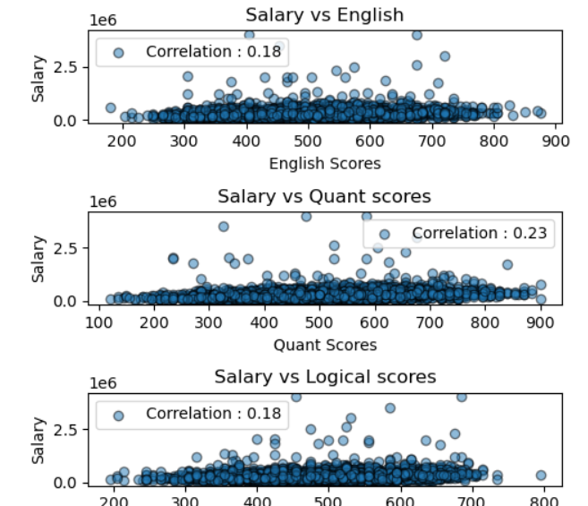
Salary vs English, quants, logical
The scatters plots above gives adequate evidence that salary is not effected by any of the above scores.

Slide 16
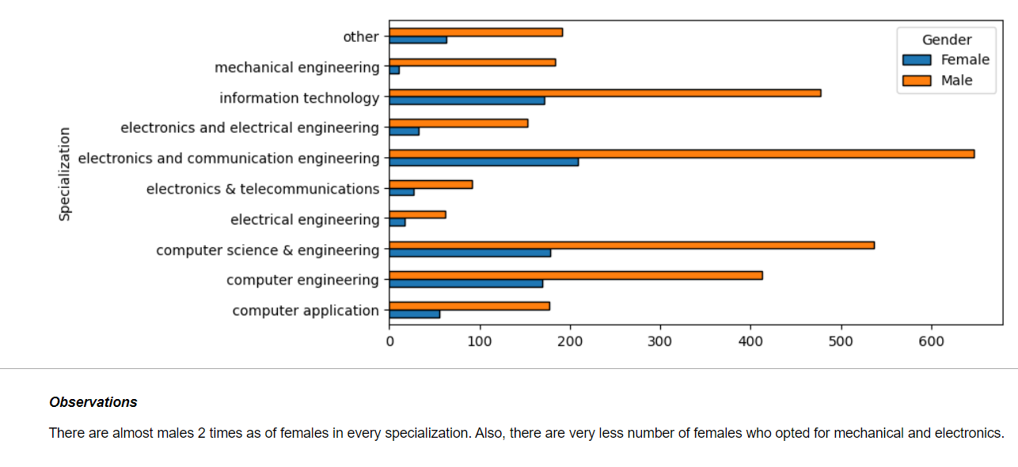
Gender vs Specialization

Slide 17
conclusion
The extensive data analysis yields several notable discoveries about the factors impacting pay levels in the dataset. While certain criteria, such as college level have a strong link with compensation, others, such as gender and academic performance, have no relationship.
Senior Software Engineers demand the greatest incomes, but with greater unpredictability, while Software Developers and Technical Support Engineers make less than the average.
Gender does not appear to play a large impact in income determination on average, yet females do receive less than the total average salary. Academic performance, as measured by 10th, 12th, and college GPA scores, does not clearly correlate with pay levels. After removing outliers, age does not appear to be a determining factor in

Slide 18

THANK YOU

